Slide 1
Introduction to Statistical Learning with Applications
CM2: Multiple linear regression
Pedro L. C. Rodrigues

Slide 2
IN OUR PREVIOUS EPISODE…
We have a set of predictors and observations

Slide 3
IN OUR PREVIOUS EPISODE…
We have a set of predictors and observations
Example: California housing dataset
Each row represents the data for one district
Median house value for California districts
Median house age in district
Median population in district
Latitude at the center of the district

Slide 4
IN OUR PREVIOUS EPISODE…
We have a set of predictors and observations and want to find a relation between them.
The objective function measures discrepancy between prediction and observations.
(mean squared error)
The solution can be obtained analytically… but in terms of an unknown quantity.

Slide 5
IN OUR PREVIOUS EPISODE…
If we assume that the data follows a linear model as in
with
Then we have that
Therefore,
Important: we made no assumptions about the specific shape of the pdf for the noise!

Slide 6

Recap on Gaussian multiple linear regression
Inference on the estimated parameters
Some important remarks
Categorical variables

Slide 7
The multiple linear regression model
We will delve further into the multiple linear regression model with p predictors
It is very important to really understand each part of this model
The intercept can be interpreted as

Slide 8
The multiple linear regression model
We will delve further into the multiple linear regression model with p predictors
It is very important to really understand each part of this model
The intercept can be interpreted as
The (with i > 0) should be interpreted as the average effect on Y of an unit increase in X_{i} while holding all other predictors fixed

Slide 9
The multiple linear regression model
We will delve further into the multiple linear regression model with p predictors
It is very important to really understand each part of this model
The intercept can be interpreted as
The (with i > 0) should be interpreted as the average effect on Y of an unit increase in X_{i} while holding all other predictors fixed
Quantity ε is a zero-mean random error term independent of X₁, … , X_{p}

Slide 10
The multiple linear regression model
When considering N observed data points from the multiple linear regression
we often rewrite things with matrix notation so to facilitate the maths afterwards

Slide 11
Estimating parameters from data
How do we estimate the parameters from the observations in X and y ?
Q:
As we saw last week, a natural loss function to minimize is the MSE
which can be approximated by

Slide 12
Estimating parameters from data
How do we estimate the parameters from the observations in X and y ?
Q:
Define the loss function
so that its minimizer is given by
Note that the predictions can be written as
projection matrix

Slide 13
Example:
Consider the Advertising dataset available [here]
Y
The observed variable is the number of sales of a particular product in different markets (e.g. different cities, neighbourhoods, etc.)
X_{i}
The predictors are the advertising budget for the product on three different media: TV, radio, and newspaper.
We will assume that a multiple linear regression model can describe the data as per
Using python we can estimate a multiple linear regression model

Slide 14
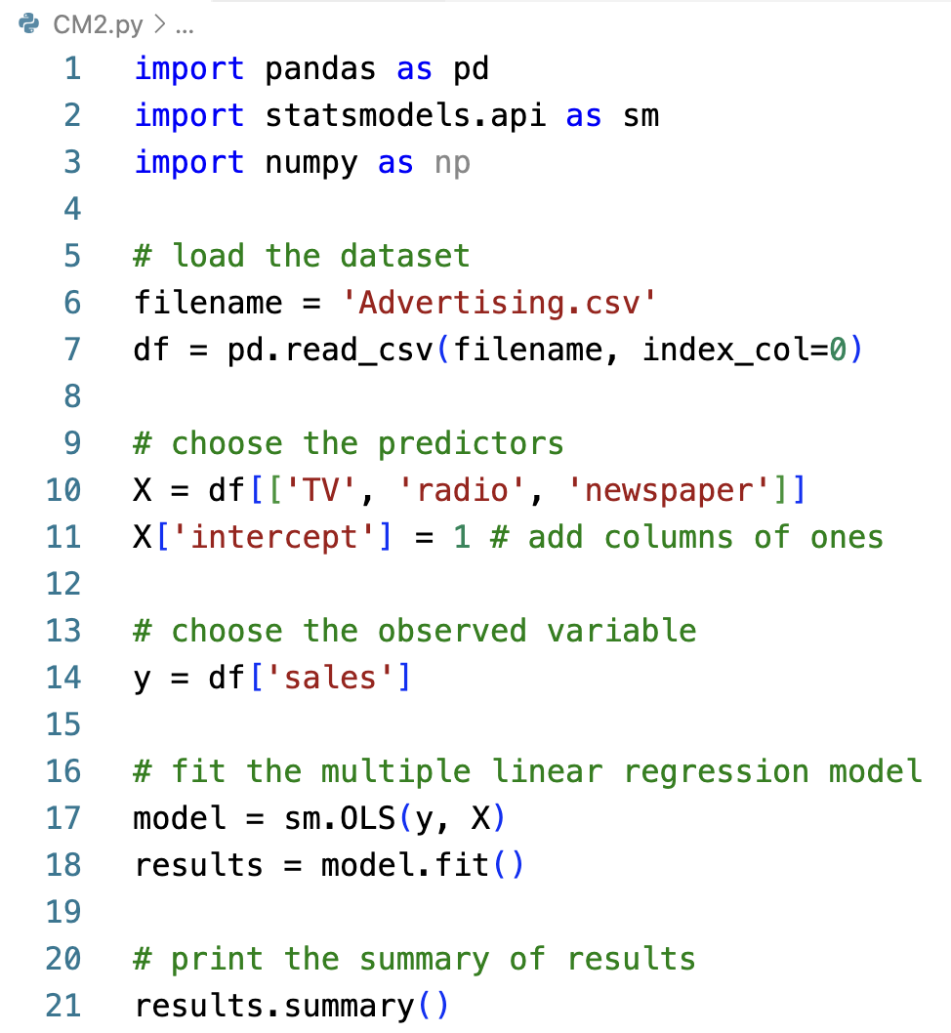
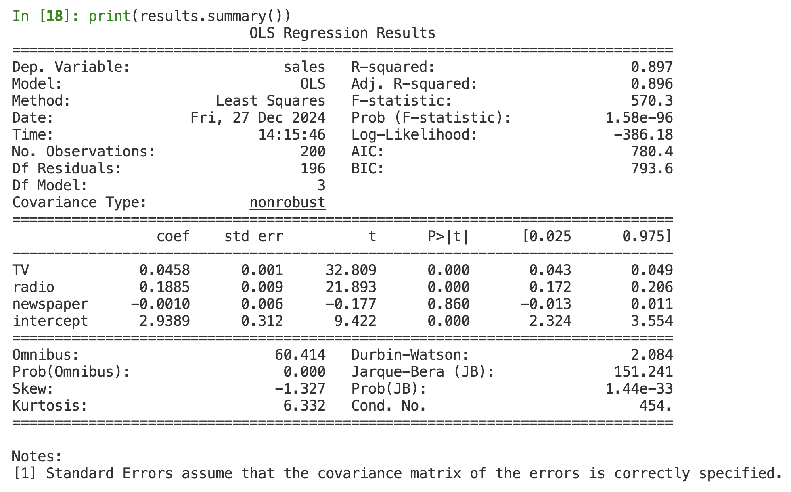
Example:
Consider the Advertising dataset available [here]

Slide 15



Example:
Consider the Advertising dataset available [here]
The fundamental package for scientific computing with Python
Fast, powerful, flexible data analysis and manipulation tool
Statistical models, hypothesis tests, and data exploration

Slide 16

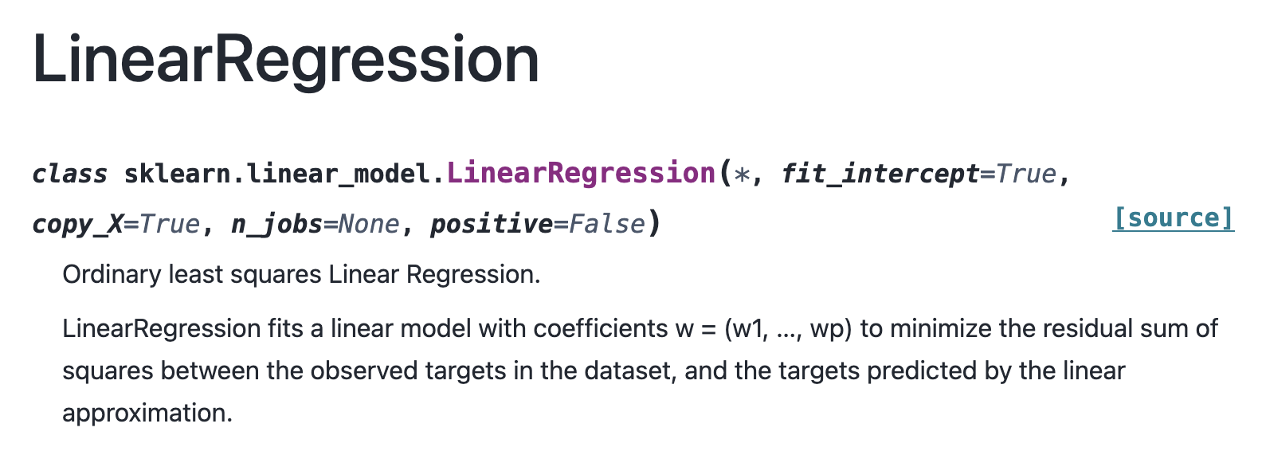
Why not scikit-learn ?
😢
Simple and efficient tools for predictive data analysis
Accessible to everybody, and reusable in various contexts
Built on NumPy, SciPy, and matplotlib
Open source, commercially usable - BSD license – Made in France 🐓🇫🇷💪🏻
However, no built-in way of doing statistical inference on the parameters, i.e. p-values

Slide 17
Example:
Consider the Advertising dataset available [here]
The coefficients for TV and newspaper are very small,
but are they statistically significant?

Slide 18
Recap on Gaussian multiple linear regression
Inference on the estimated parameters
Some important remarks
Categorical variables

Slide 19
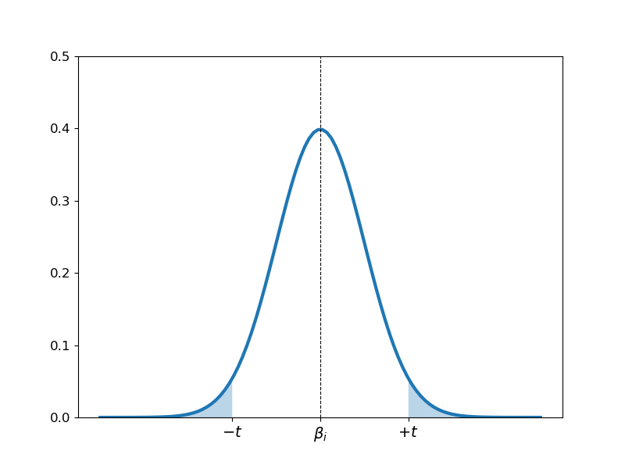
Statistical inference on the parameters
To do statistical inference on each parameter we need a statistical model
with
In this case we have that
and
We can now write a statistical hypothesis test

Slide 20
One-slide reminder of hypothesis testing
We assume the null hypothesis is valid and check whether the data push us to reject it
Calculate the test statistic from the data:
Calculate the probability of the test statistic assuming the
null hypothesis is valid
for ⍺ = 0.05 we have t_{⍺/2}=1.96
If then reject null hypothesis:
“there is very little evidence that the parameter you’ve
estimated should correspond to a model with β_{i} = 0”

Slide 22
Statistical inference on the parameters
We usually only have an estimator for the variance of the Gaussian white noise
The test statistic follows rather a t-student distribution with n-p-1 degrees of freedom
Coming back to the example:
Small but statistically significant

Slide 23
Statistical inference on the parameters
What, exactly, is statsmodels testing?
Q:
The hypothesis being tested is:
“Y is a linear function of all the X_{i} (with i between 1 and p), with constant variance, independent Gaussian white noise, and is just so happens that β_{i} = 0”
Remember that
Important: This means that whether β_{i} = 0 is true or not can depend on which other variables are included in the regression!

Slide 24
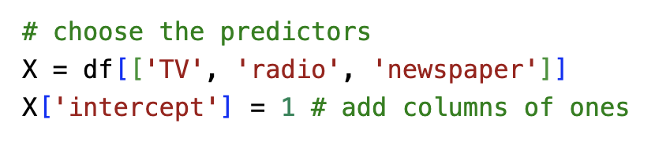
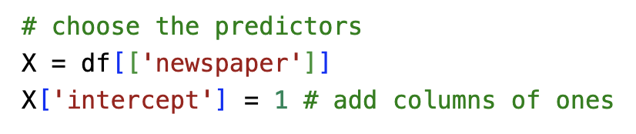
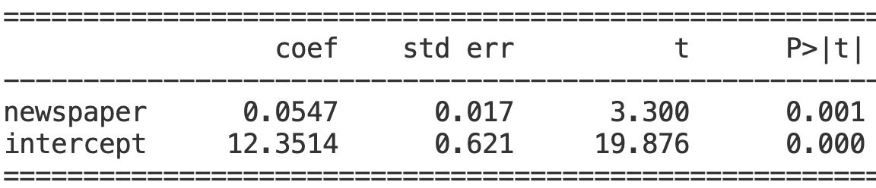
Statistical inference on the parameters
The parameter becomes statistically significant

Slide 25
Testing for multiple coefficients
It is often useful to also test for the significance of a group of coefficients
p-q coefficients are all zero
We compare the estimated MSE for each model with a F-test
“Does letting the slopes for X_{q+1}, …, X_{p} be non-zero reduce the MSE more than we would expect just by noise?”

Slide 26
Testing for multiple coefficients
An important special case is to test if all coefficients are zero or not.
The test statistic becomes then
which is often called the test of significance of the whole regression.

Slide 27
Example:
Consider the mtcars dataset – we want to predict mpg

Slide 28
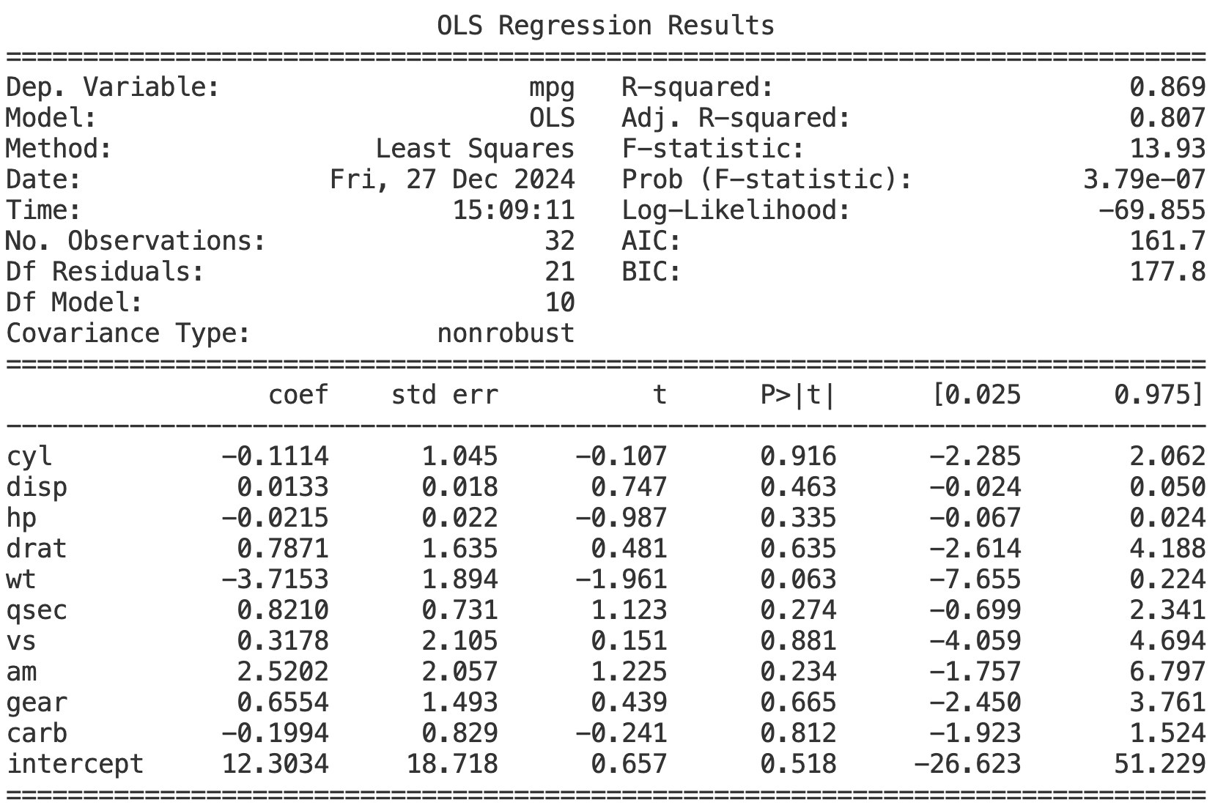
… but the F-test does
🤯
None of the t-tests reject H₀

Slide 29
Recap on Gaussian multiple linear regression
Inference on the estimated parameters
Some important remarks
Categorical variables

Slide 30
Q:
Why multiple regression isn’t a bunch of simple regressions?
“The slopes we get for each variable in multiple regression are not the same as if we did p separate simple regression. Why not?”
Suppose the true model of the data is
If we did a simple regression of Y just on X₁ we would estimate the slope as per
indirect contribution through correlation with X₂
X₁’s direct contribution to Y
X₂’s contribution to Y
When X₁ and X₂ are correlated, we can predict a bit of X₁ from X₂ and vice-versa

Slide 31
Multicollinearity
Remember the expression for the parameters of the multiple linear regression model
We have always assumed is invertible. What happens if it is not the case?
The variance of the estimated parameters will blow up!
(And even if it’s not exactly singular but almost, the variances will be very big)
The test statistic is
so H₀ will very often not be rejected
Let’s see an example…

Slide 32
None of the t-tests reject H₀

Slide 33
Recap on Gaussian multiple linear regression
Inference on the estimated parameters
Some important remarks
Categorical variables

Slide 34
Handling categorical predictors
In some cases, we might want to regress Y using also qualitative predictors:
“How does the salary of an employee relates with its gender?”
“Can the nationality of a person help predict his/her life expectancy?”
These are examples where the levels of the predictor have no notion of ordering
Binary categories
Pick one of two levels as the reference or baseline category.
Add column X_{B} to the design matrix X for each data point indicating whether it belongs to baseline (X_{B} = 1) or not (X_{B} = 0)
Regress on
(One-hot encoding)
Dummy variable encoding categories
Continuous predictors

Slide 35
Handling categorical predictors: the binary case
Consider having one continuous predictor and one binary categorial predictor
We have that the coefficient for the categorial predictors is
“It’s the expected difference in the response between members of the reference category and members of the other category, all else being equal”
There are basically two models with different intercepts:
model for the baseline category
model for the other category

Slide 36
Handling categorical predictors: the binary case
Example:
We want to regress the effective life of an industrial tool before it needs maintenance based on two predictors:
How much stress we impose to the tool (i.e. rotation speed)
Its brand (either A or B)
model for brand B
model for brand A

Slide 37
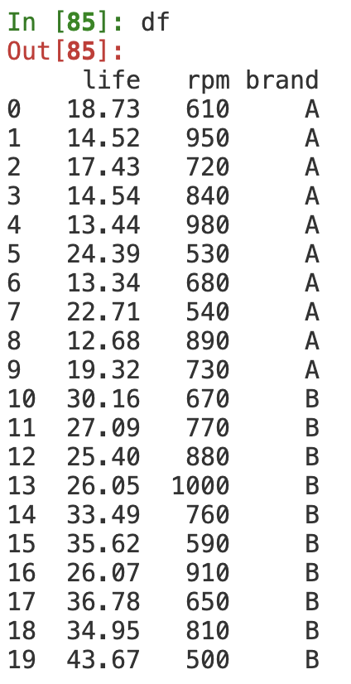
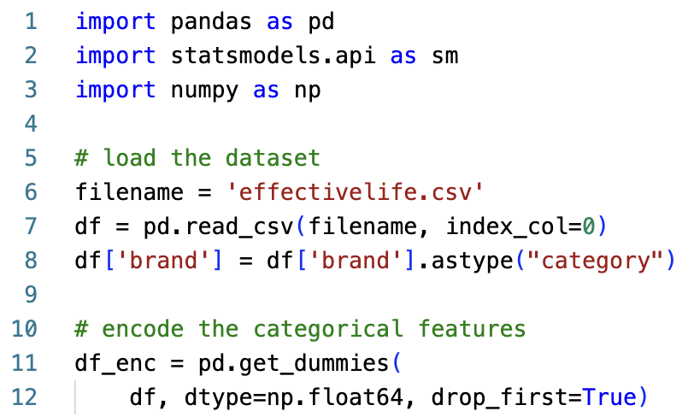
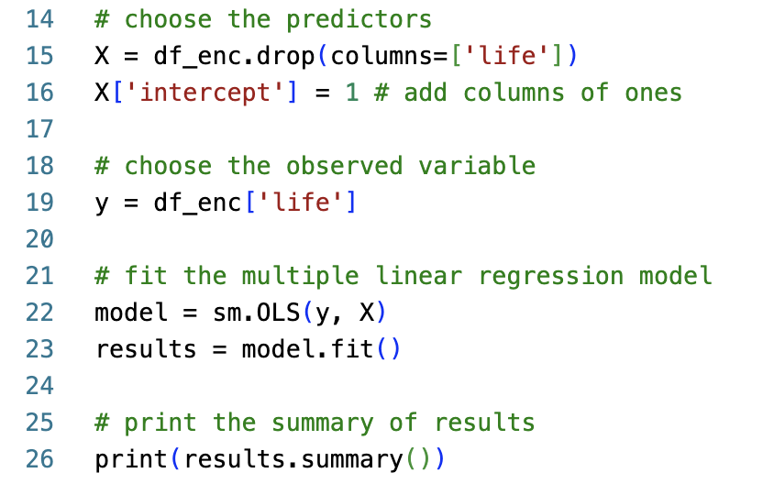
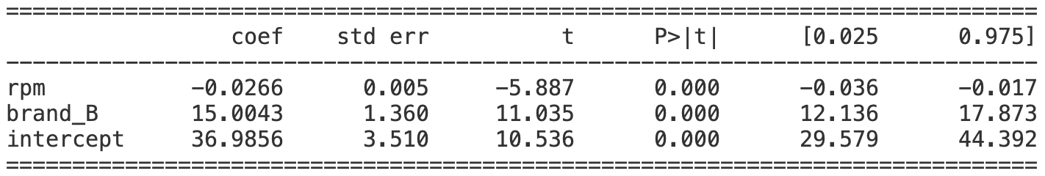
Handling categorical predictors

Slide 38
Handling categorical predictors
Q:
Why not add two columns to the design matrix? (one for each level)
A:
The two columns would be linearly dependent (they will always add up to one) so the data would end up being collinear → problems with inversion.
Q:
Why not two slopes? (one for each level)
A:
This is perfectly reasonable, but would require a different kind of linear model using interactions between predictors. We won’t see this in this course.

Slide 39
Handling categorical predictors
If our categorical predictor has more than just two levels, we can simply
Pick one of the k levels as the reference or baseline category.
Add k-1 columns to the design matrix X which are indicators for the other categories.
Regress as usual, getting k-1 constrasts for the categorical predictors
In our previous example, if we had three levels for the brand (A, B, or C) we would get
if brand A
if brand B
if brand C

Slide 40
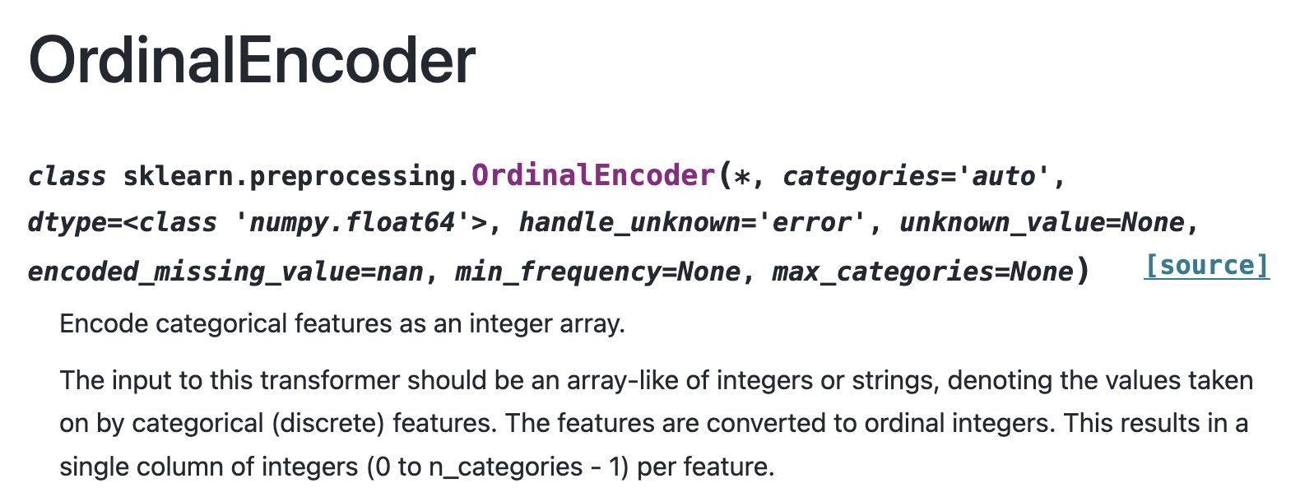
Handling categorical predictors
But what if we have too many categories? This would make the data matrix too big!
One idea, would have been to try using an ordinal encoder from scikit-learn`

Slide 41
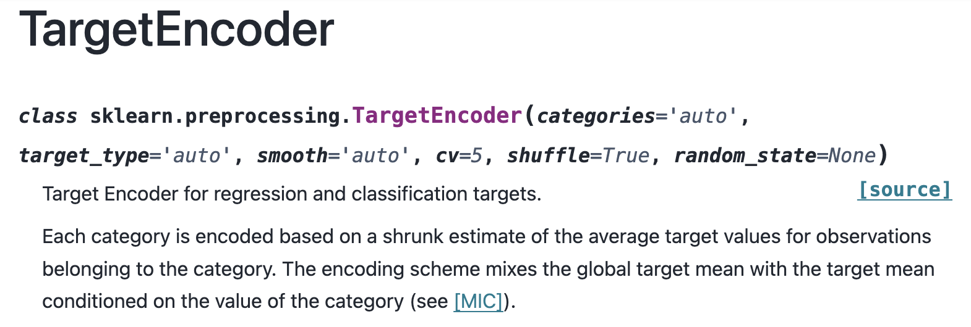
Handling categorical predictors
But what if we have too many categories? This would make the data matrix too big!
Another possibility would be to use a target encoder from scikit-learn too.

Slide 42
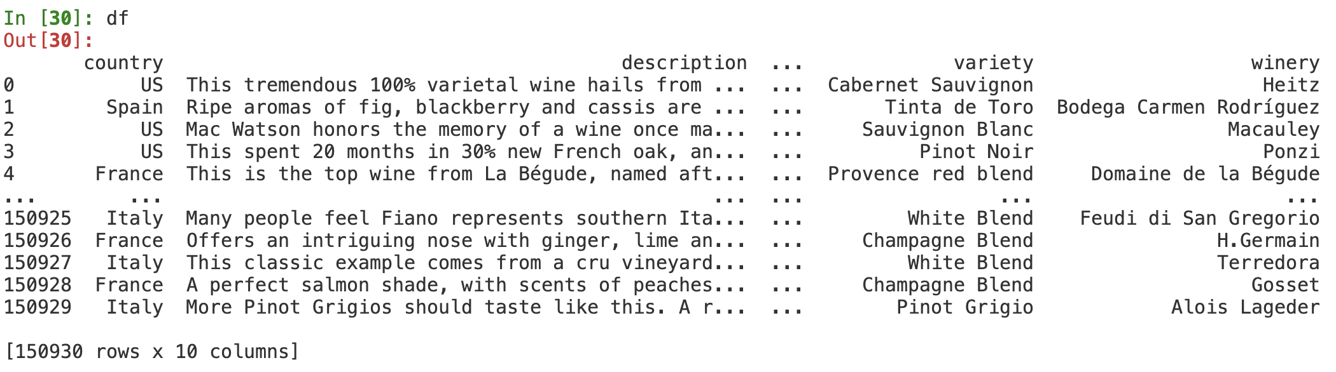
Handling categorical predictors
But what if we have too many categories? This would make the data matrix too big!
Let’s consider an example with a winereviews dataset
We want to predict the points columns (values between 80 and 100) based on the other predictors from the dataframe: 6 categorical and 1 numerical

Slide 43
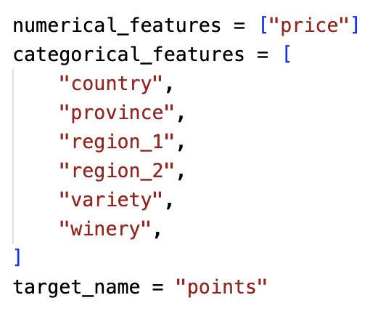
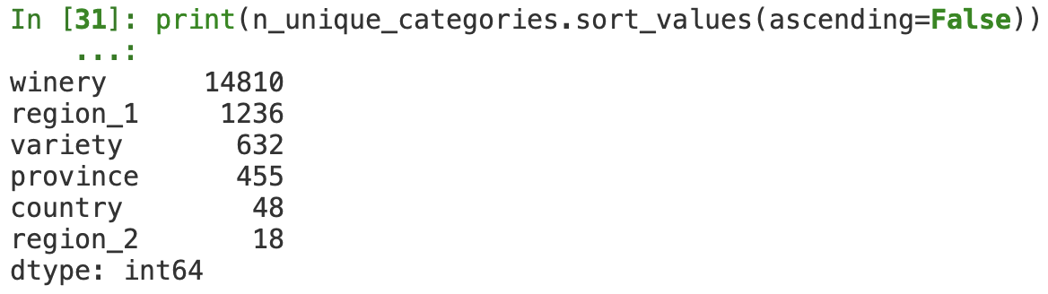
Handling categorical predictors
But what if we have too many categories? This would make the data matrix too big!
Let’s consider an example with a winereviews dataset
Let’s compare the performance of regression with different encoding schemes.
Forget about inference for now, focus on predictive power

Slide 44
Handling categorical predictors
But what if we have too many categories? This would make the data matrix too big!
Let’s consider an example with a winereviews dataset

Slide 45
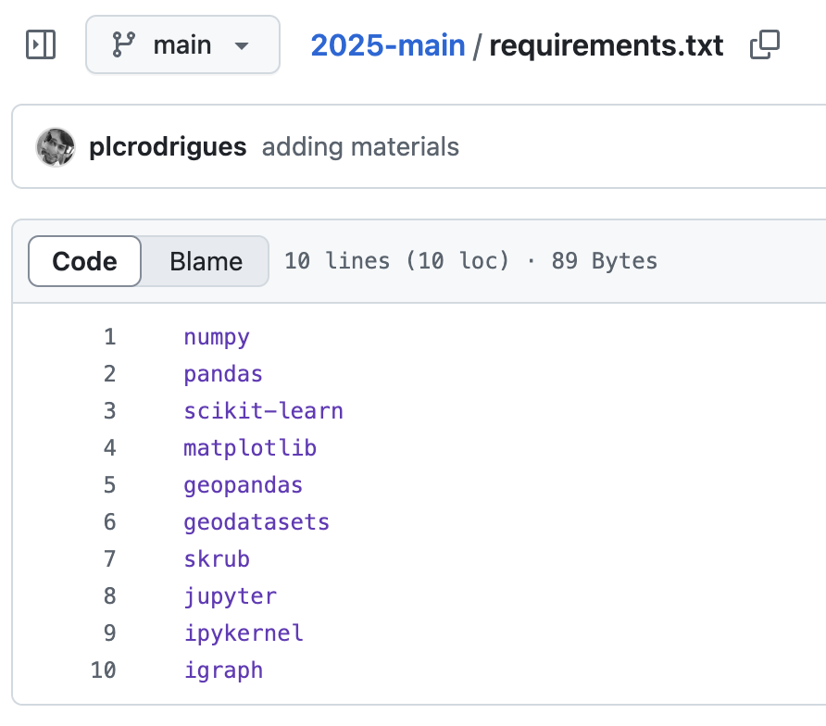
Before going to the TP rooms…
If you’re using your own computer, please be sure to install all the packages necessary for our class.
Just follow these three steps…
Install conda
Run conda create -n isla2026 python=3.12
Run pip install -r requirements.txt

Slide 46
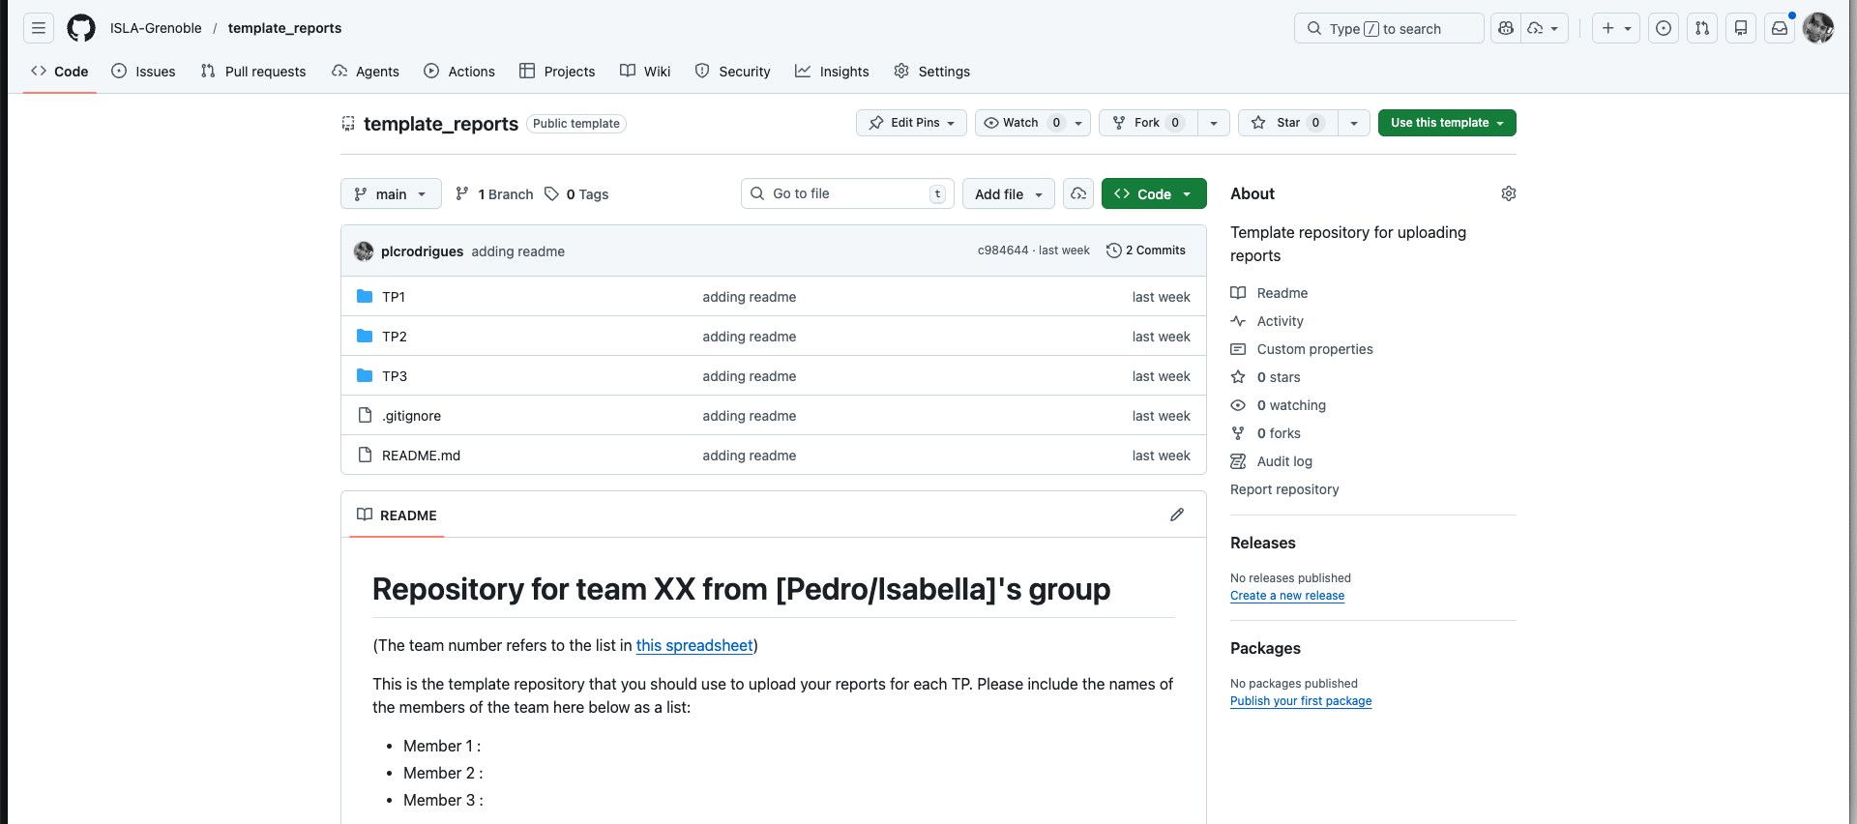
Before going to the TP rooms…
Make sure to fill the spreadsheet with the info of your TP team:
https://docs.google.com/spreadsheets/d/1uyknHZdo-aYezE2FsCAuc40igH8JJyGHZquvS-jjN3g/edit?usp=sharing
Important: the TP reports should be uploaded on a github repo of your team

